Slide 1

"Design And Implementation Of Flower Prediction Model Using CNN"
Under the guidance of Prof. Shruthi G
Submitted by Suhas M C – 1MS19IS121
Vinayak Rama Gouda– 1MS20IS411
Suhas P- 1MS18IS108
Pradyumna G Patil – 1MS19IS089
Dept of Information Science & Engineering
Mini Project - ISE

Slide 2
Index
Abstract
Problem Statement
Literature Survey
Methodology
Result
Summary
References

Slide 3
Abstract
Identification of flowers is an essential part in the day-to-day life of people involved in nature such as horticulture, photography, gardening. To find the type of flower from just the image is proved a tedious task either by asking others or by searching the internet based on the features of the flower which may lead us to inconclusive results.
It is easier to select the types of flowering plants if we establish the criteria such as colours, fragrance, blooming period, height, maintenance, and the category they belong to. It helps us remember different flowering plants if we organize them into categories.

Slide 4
Problem Statement
Due to the need of an efficient way of detection of species of flowers, we will be using the CNN deep leaning model for flower classification.
This solves the problem of identification of species of flowers by manual searching of flowers with only the respective flower description.

Slide 5
LITERATURE SURVEY
SNo | Paper Title, Author, Year of Publication | Objective | Abstract , Technique mentioned | Dataset | Observation
1 | Convolutional Neural Network and Support Vector Machines in Transfer Learning: 2022 Ari Peryato, Anton Yudhana, Rusyadhi Umar | To compare the Deep Neural Network and Classic Machine Learning models using CNN | Achieve the goal by preprocessing, sharing training and testing data using CNN and SVM methods | Dataset of 1200 images obtained from Google divided into 3 classes: namely Rose, Tulip and Aster | SVM is found out to have a comparatively lesser accuracy than SVM but both need to be combined together to obtain high accuracies
2 | Flower Classification and Recognition based on Significance Test and Transfer Learning: 2021 Rongxin Lv, Zhongzhi Li, Jiankai Zuo, Jing Lu | To establish a flower classification model based on the traditional VGG-16 network | Obtaining the final result by salient region extraction, transfer learning and model optimisation | Oxford 102 public dataset which contains 102 flower categories with each category having 40-258 pictures with a total of 8189 pictures | Proves it is more feasible than other deep learning networks with a high accuracy

Slide 6
SNo | Paper Title, Author, Year of Publication | Objective | Abstract , Technique mentioned | Dataset | Observation
3 | Flower classiﬁcation with modiﬁed multimodal convolutional neural Networks: 2020 Kang Il Bae a , Junghoon Park a ,Jongga Lee a ,Yungseop Lee b , Changwon Lim | To the consensus princi- ple in the multi-view learning since it is constructed to maximize the agreement on image and text features | We adopted multi-view learning princi- ple and applied deep learning methods. | Oxford 102 Category Flower Dataset is given as a set of train- ing, | These conventional methods have limitations in that human beings should choose arbitrary ﬁlters manually.
4 | Flower Classification using Supervised Learning: 2019 Asmita Shukla Ankita Agarwal Hemlata Pant Priyanka Mishra | To simplify the representation of the flower and to provide something which is more significant and easier to analyze. | The learning methods of Machine Learning are of three types these are supervised, unsupervised and reinforcement learning. | Iris dataset identifies the sub classes of Iris flower. | Classification which is the sub part of supervised learning where the computer program learns from the input given to it and uses this learning to classify new observation.

Slide 7
SNo | Paper Title, Author, Year of Publication | Objective | Abstract , Technique mentioned | Dataset | Observation
5 | Simulation of Back Propagation Neural Network for Iris Flower Classification: 2017 R.A.Abdulkadir1 ,Khalipha A. Imam2 M.B. Jibril3 | To demonstrate how some of these issues can be tackled by back propagation neural network. | We adopted multi-view learning princi- ple and applied deep learning methods. | Fischer’s Iris dataset which contains 3 classes of 50 instances each | The successfully trained neural network classified the testing data correctly; indicating 100% recognition.
6 | Flower Classification using Fusion Descriptor and SVM: 2017 Wei Liu, Yunbo Rao, Baijiang Fan, Jiali Song, Qifei Wang | Aims to develop an effective flower classification approach using the technology of feature extraction. | A fused descriptor based on Pyramid Histogram of Visual Words (PHOW) is used to extract the color, texture and contour information of flower image | Oxford 17 public dataset which contains 17 flower categories with 80 images of each | Compared to other three kernels, we made a conclusion that the HIK SVM has a relative higher accuracy precision and less time cost than Linear and RBF kernel for flower classification.

Slide 8
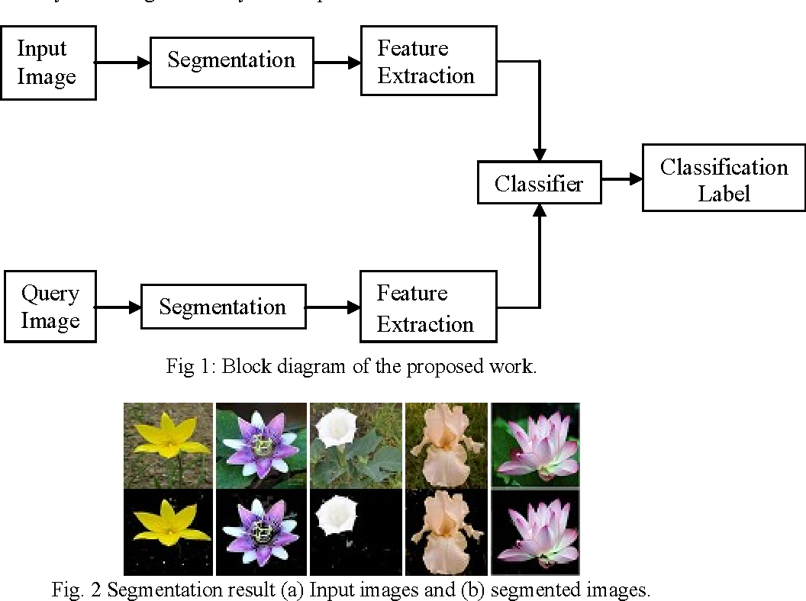
Project Workflow

Slide 9
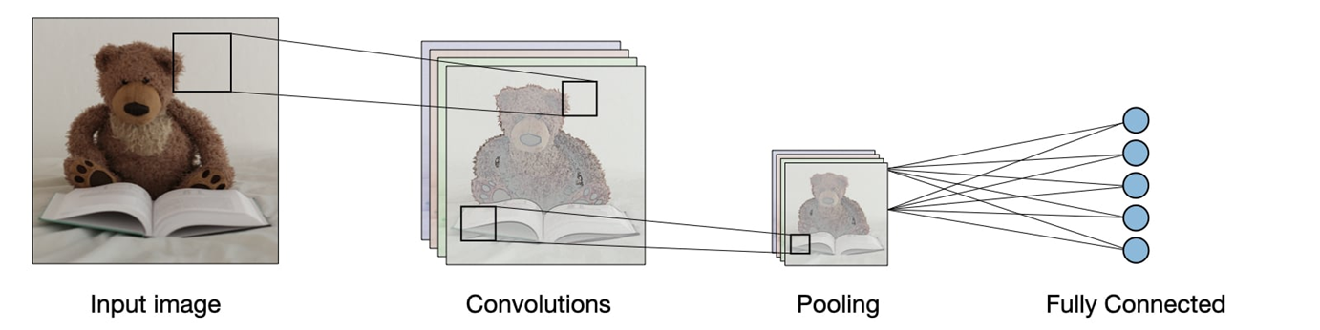
methodology
In our project we will be using convolutional neural network concept to detect the flower features.
The main advantage of CNN compared to its predecessors is that it automatically detects the significant features without any human supervision which made it the most used model among many research papers.
It shows one of the highest accuracies while compared to other machine learning and deep learning algorithms.

Slide 10
time complexity comparision
The GPU commonly used in Google Colab is the Tesla T4 GPU. It is an energy-efficient 70-watt, small PCIe form factor, T4 is optimized for mainstream computing environments and features multi-precision Turing Tensor Cores.
Tensor cores are useful where there are workloads which involve the fields of ML,DL and AI. Time complexity of the input workload reduces drastically leading to faster outputs.
Due to the underlying architecture of the GPU, it also enables the model to be trained to be more accurate than the model trained solely by the CPU.

Slide 11
Partial implementation
We will be using Oxford 102 flower dataset due to its exhaustive resource of different types of flowers
Project is run on laptop with minimal hardware configurations, laptop with high specification GPU and Google colab GPU to compare the resulting times taken to complete the training and the resultant accuracy.
Our project will be run inside jupyter notebook with local GPU and CPU

Slide 12
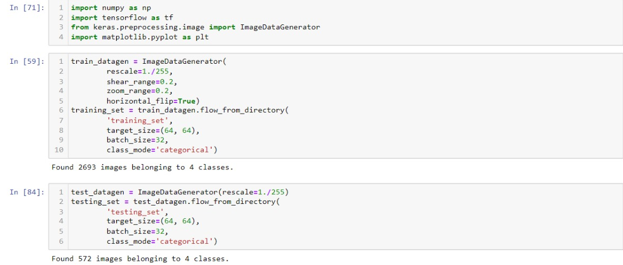
Preprocessing

Slide 13
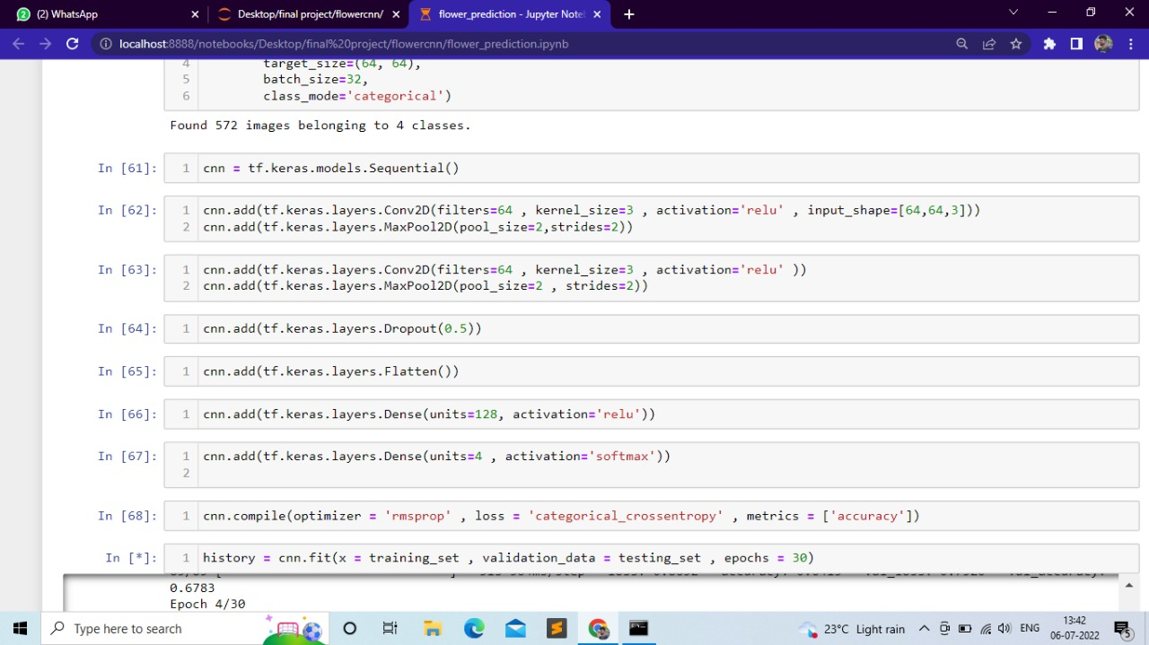
Code

Slide 14
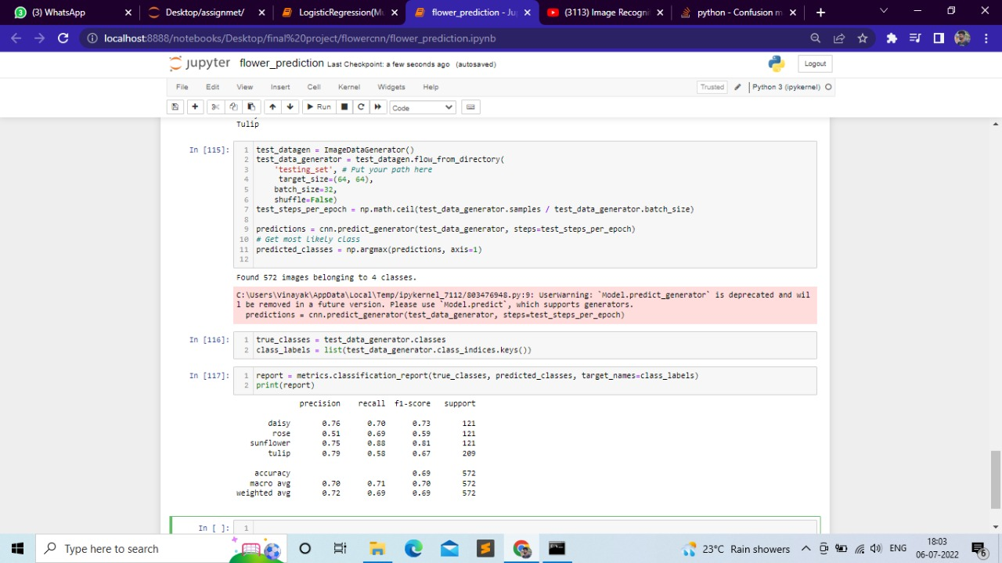
Result

Slide 15
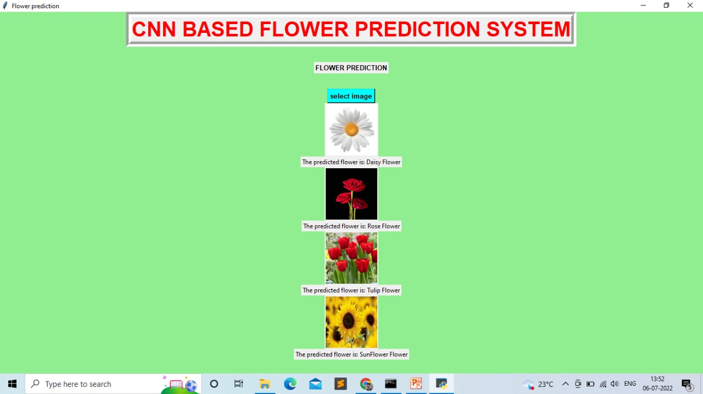
Output

Slide 16
Summary
From our project creation, it was found that the GPU utilisation of Colab was very less due to load on Google servers and inability to provision cloud resources whereas the most performant format for model training was to use the laptop with a high performant GPU. Our results show us a range of about 90% accuracy along with precision, recall and F1 scores falling in the range of 70% accuracy with slight variations in the different classes.
The resultant time taken for execution was in the descending order of time with Google Colab GPU taking 1 hour, the local machine with CPU taking 14 minutes and a local machine with a high end GPU taking 7 minutes.

Slide 17
References
[1] Avishiktha Lodh, Ranjan Parekh,”Flower Recognition System based on Color and Gist Features”, IEEE 2017
[2] Busra Rumeysa Mete, Tolga Ensari,”Flower Classification with Deep CNN and Machine Learning Algorithms, IEEE 3 rd International Symposium on Multidisciplinary Studies and Innovative Technologies,2019
[3]TanakornTiay, Pipimphorn Benyaphaichit,Panomkhawn Riyamongkol,”Flower Recognition System Based ON Image Processing, IEEE Third ICT international Student Project Conference, 2014
[4] D S Guru,Y H Sharath and S Mnajunath,”Texture Features in Classification of Flower Images”, IJCA Special Issue on RTIPP
[5] Flower Classification using Fusion Descriptor and SVM: 2017Wei Liu, Yunbo Rao, Baijiang Fan, Jiali Song, Qifei Wang
[6] Simulation of Back Propagation Neural Network for Iris Flower Classification: 2017 R.A.Abdulkadir1 ,Khalipha A. Imam2 M.B. Jibril3
[7] Flower Classification using Supervised Learning: 2019 Asmita Shukla Ankita Agarwal Hemlata Pant Priyanka Mishra
[8] Flower classiﬁcation with modiﬁed multimodal convolutional neural Networks: 2020 Kang Il Bae a , Junghoon Park a ,Jongga Lee a ,Yungseop Lee b , Changwon Lim
[9] Flower Classification and Recognition based on Significance Test and Transfer Learning: 2021Rongxin Lv, Zhongzhi Li, Jiankai Zuo, Jing Lu
[10] Convolutional Neural Network and Support Vector Machines in Transfer Learning: 2022 Ari Peryato, Anton Yudhana, Rusyadhi Umar

